Slide 1
Chapter 26
Exotic Options

Slide 2
Types of Exotics
Packages
Perpetual American calls and puts
Nonstandard American options
Gap options
Forward start options
Cliquet options
Compound options
Chooser options
Barrier options
Binary options
Lookback options
Shout options
Asian options
Options to exchange one asset for another
Options involving several assets
Volatility and Variance swaps

Slide 3
Packages (Section 26.1)
Portfolios of standard options
Examples from Chapter 11: bull spreads, bear spreads, straddles, etc
Often structured to have zero cost
One popular package is a range forward contract (see Chapter 17)

Slide 4

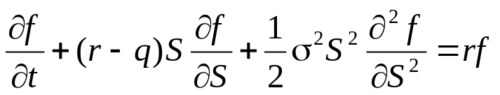
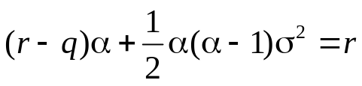

Perpetual American Options (Section 26.2)
Consider first a derivative that pays off Q when S = H for the first time and S₀ < H
(α > 0) satisfies the boundary conditions. It satisfies the differential equation
when
This has solutions α₁>0 and α₂<0
The value of the derivative is therefore

Slide 5


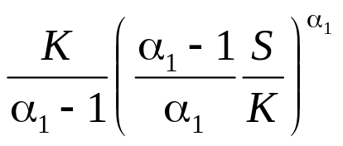
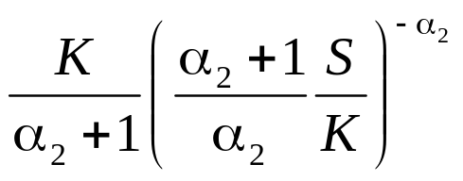
Perpetual American Options continued
Consider next a perpetual American call option with strike price K
If it is exercised when S=H the value is
This is maximized when
The value of the perpetual call is therefore
The value of a perpetual put is similarly

Slide 6
Non-Standard American Options (Section 26.3)
Exercisable only on specific dates (Bermudans)
Early exercise allowed during only part of life (initial “lock out” period)
Strike price changes over the life (warrants, convertibles)

Slide 7
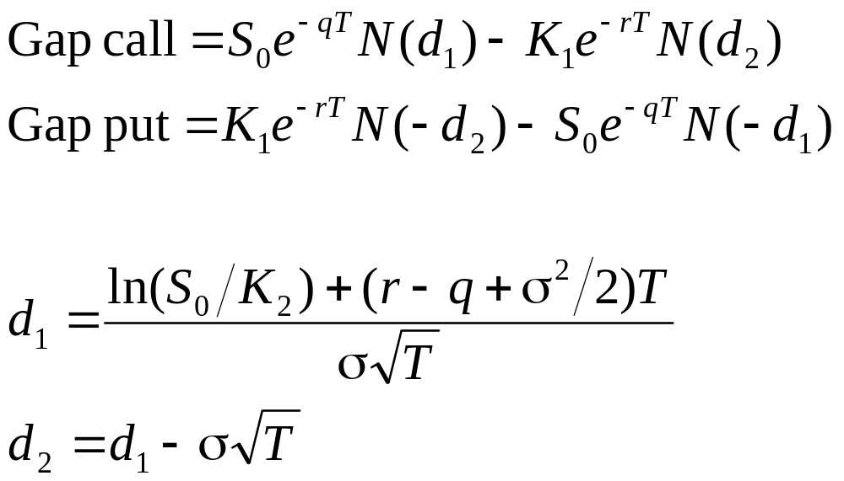
Gap Options (equations 26.1 and 26.2)
Gap call pays S_{T} − K₁ when S_{T} > K₂
Gap put pays off K₁ − S_{T} when S_{T} < K₂
Can be valued with a small modification to BSM

Slide 8

Forward Start Options (Section 26.5)
Option starts at a future time, T₁
Implicit in employee stock option plans
Often structured so that strike price equals asset price at time T₁
Value is then times the value of similar option starting today

Slide 9
Cliquet Option (Section 26.6)
A series of call or put options with rules determining how the strike price is determined
For example, a cliquet might consist of 20 at-the-money three-month options. The total life would then be five years
When one option expires a new similar at-the-money is comes into existence

Slide 10
Compound Options (Section 26.7)
Option to buy or sell an option
  Call on call
  Put on call
  Call on put
  Put on put
Can be valued analytically
Price is quite low compared with a regular option

Slide 11
Chooser Option “As You Like It” (Section 26.8)
Option starts at time 0, matures at T₂
At T₁ (0 < T₁ < T₂) buyer chooses whether it is a put or call
This is a package!

Slide 12
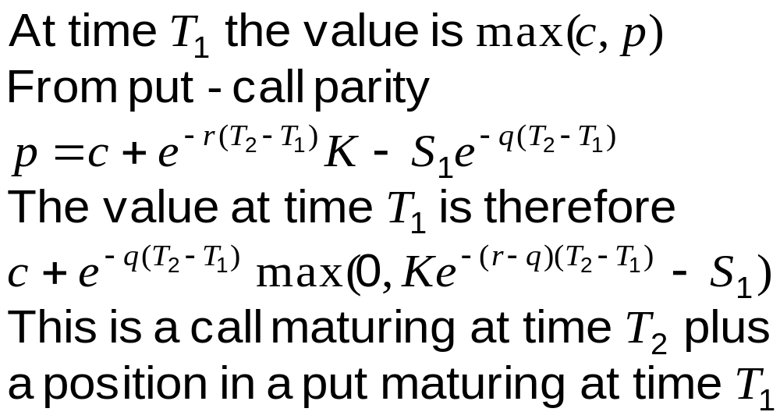
Chooser Option as a Package

Slide 13
Barrier Options (Section 26.9)
Option comes into existence only if stock price hits barrier before option maturity
  ‘In’ options
Option dies if stock price hits barrier before option maturity
  ‘Out’ options

Slide 14
Barrier Options (continued)
Stock price must hit barrier from below
  ‘Up’ options
Stock price must hit barrier from above
  ‘Down’ options
Option may be a put or a call
Eight possible combinations

Slide 15
Parity Relations
c = c_{ui} + c_{uo}
c = c_{di} + c_{do}
p = p_{ui} + p_{uo}
p = p_{di} + p_{do}

Slide 16
Binary Options (Section 26.10)
Cash-or-nothing: pays Q if S_{T} > K, otherwise pays nothing.
  Value = e^{–rT} Q N(d₂)
Asset-or-nothing: pays S_{T} if S_{T} > K, otherwise pays nothing.
  Value = S₀e^{-qT} N(d₁)

Slide 17
Decomposition of a Call Option
Long: Asset-or-Nothing option
Short: Cash-or-Nothing option where payoff is K
Value = S₀e^{-qT} N(d₁) – e^{–rT} KN(d₂)

Slide 18
Lookback Options (Section 26.11)
Floating lookback call pays S_{T} – S_{min} at time T (Allows buyer to buy stock at lowest observed price in some interval of time)
Floating lookback put pays S_{max}– S_{T} at time T
(Allows buyer to sell stock at highest observed price in some interval of time)
Fixed lookback call pays max(S_{max}−K, 0)
Fixed lookback put pays max(K −S_{min}, 0)
Analytic valuation for all types

Slide 19
Shout Options (Section 26.12)
Buyer can ‘shout’ once during option life
Final payoff is either
  Usual option payoff, max(S_{T} – K, 0), or
  Intrinsic value at time of shout, S_{τ} – K
Payoff: max(S_{T} – S_{τ} , 0) + S_{τ} – K
Similar to lookback option but cheaper

Slide 20
Asian Options (Section 26.13)
Payoff related to average stock price
Average Price options pay:
  Call: max(S_{ave} – K, 0)
  Put: max(K – S_{ave} , 0)
Average Strike options pay:
  Call: max(S_{T} – S_{ave} , 0)
  Put: max(S_{ave} – S_{T} , 0)

Slide 21
Asian Options
No exact analytic valuation
Can be approximately valued by assuming that the average stock price is lognormally distributed

Slide 22
Exchange Options (Section 26.14)
Option to exchange one asset for another
For example, an option to exchange one unit of U for one unit of V
Payoff is max(V_{T} – U_{T}, 0)

Slide 23
Basket Options (Section 26.15)
A basket option is an option to buy or sell a portfolio of assets
This can be valued by calculating the first two moments of the value of the basket at option maturity and then assuming it is lognormal

Slide 24
Volatility and Variance Swaps (Section 26.16)
Volatility swap is agreement to exchange the realized volatility between time 0 and time T for a prespecified fixed volatility with both being multiplied by a prespecified principal
Variance swap is agreement to exchange the realized variance rate between time 0 and time T for a prespecified fixed variance rate with both being multiplied by a prespecified principal
Daily return is assumed to be zero in calculating the volatility or variance rate

Slide 25
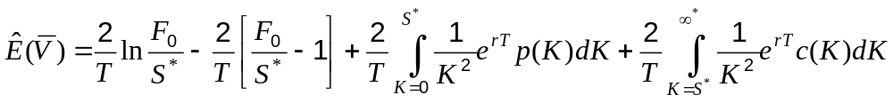
Variance Swap (equation 26.6)
The (risk-neutral) expected variance rate between times 0 and T can be calculated from the prices of European call and put options with different strikes and maturity T
For any value of S*

Slide 26
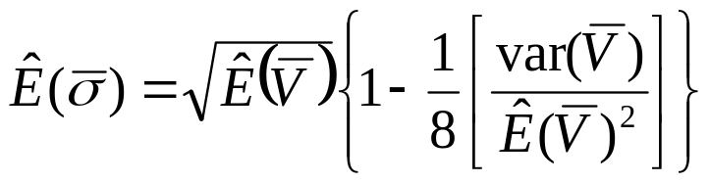
Volatility Swap (equation 26.9)
For a volatility swap it is necessary to use the approximate relation

Slide 27
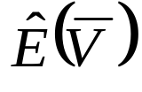
VIX Index
The expected value of the variance of the S&P 500 over 30 days is calculated from the CBOE market prices of European put and call options on the S&P 500 using the expression for
This is then multiplied by 365/30 and the VIX index is set equal to the square root of the result

Slide 28
How Difficult is it to
Hedge Exotic Options?
In some cases exotic options are easier to hedge than the corresponding vanilla options (e.g., Asian options)
In other cases they are more difficult to hedge (e.g., barrier options)

Slide 29
Static Options Replication
(Section 26.17)
This involves approximately replicating an exotic option with a portfolio of vanilla options
Underlying principle: if we match the value of an exotic option on some boundary , we have matched it at all interior points of the boundary
Static options replication can be contrasted with dynamic options replication where we have to trade continuously to match the option

Slide 30
Example
A 9-month up-and-out call option an a non-dividend paying stock where S₀ = 50, K = 50, the barrier is 60, r = 10%, and σ = 30%
Any boundary can be chosen but the natural one is
c (S, 0.75) = max(S – 50, 0) when S < 60
c (60, t ) = 0 when 0 ≤ t ≤ 0.75

Slide 31
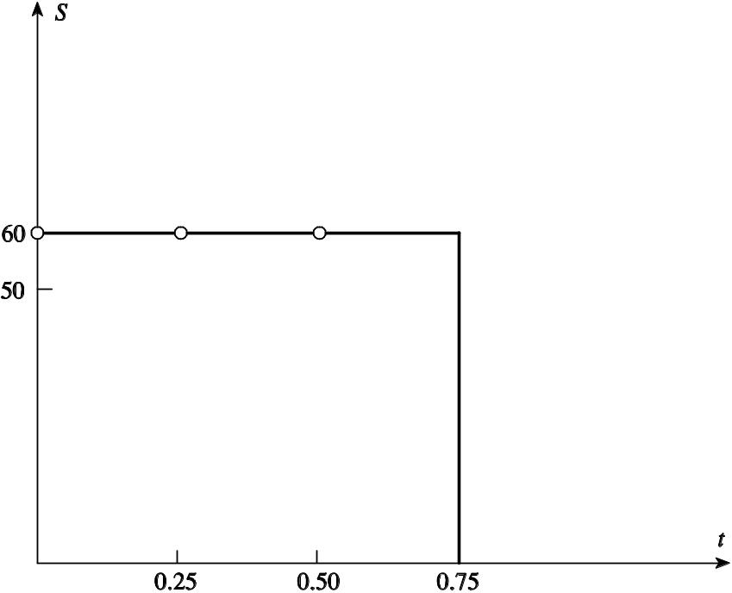
The Boundary (Figure 26.1)

Slide 32
Example (continued)
We might try to match the following points on the boundary
c(S , 0.75) = MAX(S – 50, 0) for S < 60
c(60, 0.50) = 0
c(60, 0.25) = 0
c(60, 0.00) = 0

Slide 33
Example continued
(See Table 26.1)
We can do this as follows:
+1.00 call with maturity 0.75 & strike 50
–2.66 call with maturity 0.75 & strike 60
+0.97 call with maturity 0.50 & strike 60
+0.28 call with maturity 0.25 & strike 60

Slide 34
Example (continued)
This portfolio is worth 0.73 at time zero compared with 0.31 for the up-and out option
As we use more options the value of the replicating portfolio converges to the value of the exotic option
For example, with 18 points matched on the horizontal boundary the value of the replicating portfolio reduces to 0.38; with 100 points being matched it reduces to 0.32

Slide 35
Using Static Options Replication
To hedge an exotic option we short the portfolio that replicates the boundary conditions
The portfolio must be unwound when any part of the boundary is reached

